Slide 1
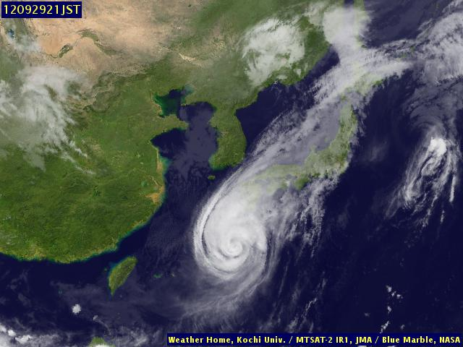
Analysis of typhoon's data
Typhoon No.17 in 2012

Slide 2
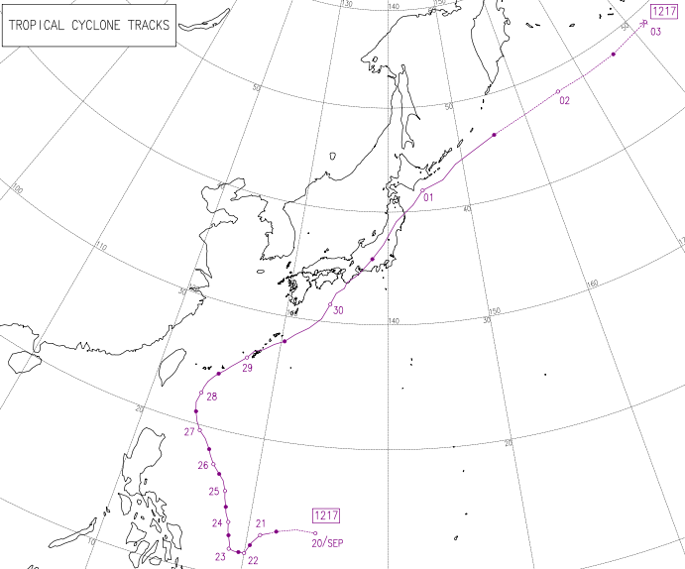
The Track of Typhoon 17 , 2012
This is a track of Typhoon 17.
The period is from September
to October 2012.
The Japan Meteorological Agency

Slide 3
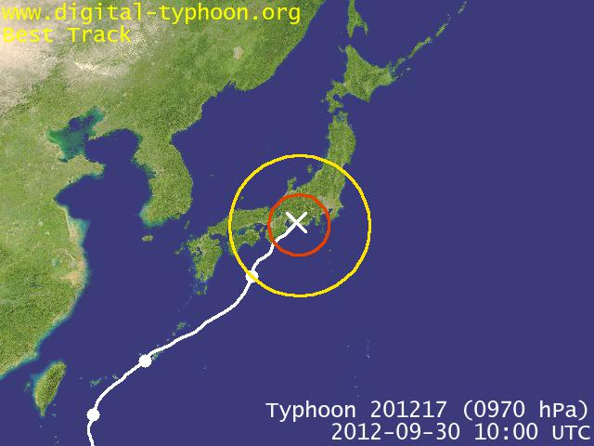
The Track of Typhoon 17 in 2012
Toyohashi City
This typhoon struck near Toyohashi City.
http://agora.ex.nii.ac.jp/~kitamoto/

Slide 4
The first analysis
of the typhoon's data is to
research the difference between
the wind speed of the right side
of the typhoon and ones from
the left side.

Slide 5
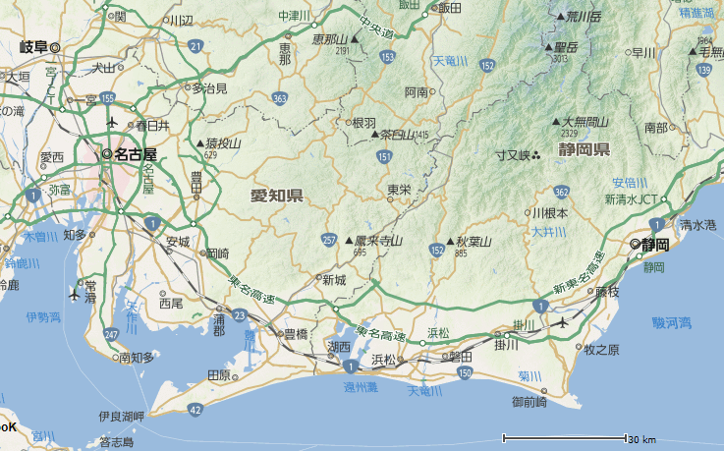
The Track of Typhoon 17 , 2012
This red arrow shows the track of Typhoon 17.
Nagoya
Ｔ
Shizuoka
Omaezaki
Toyohashi
Yahoo

Slide 6
The Track of Typhoon 17 , 2012
Nagoya
Ｔ
Shizuoka
Toyohashi City is
situated in Shizuoka Prefecture.
Omaezaki
Toyohashi
Yahoo

Slide 7
The Track of Typhoon 17 , 2012
Shizuoka City and Omaezaki City are situated on the east side or
the right side of Toyohashi City.
Omaezaki City is nearer to Toyohashi City than Shizuoka City.
Nagoya
Ｔ
Shizuoka
Omaezaki
Toyohashi
Yahoo

Slide 8
The Track of Typhoon 17 , 2012
Nagoya
Ｔ
Shizuoka
Nagoya City is
situated on the
west side or
left side of
Toyohashi City.
Omaezaki
Toyohashi
Yahoo

Slide 9
The Track of Typhoon 17 , 2012
Why?
The viewpoint is that the wind speed of the east side of typhoon's course is stronger than ones of the west side of typhoon's course.
Nagoya
Ｔ
Shizuoka
Omaezaki
Toyohashi
Yahoo

Slide 10
The Track of Typhoon 17 , 2012
The red arrows are the winds that pressured the typhoon to go north.
Nagoya
Ｔ
Shizuoka
Omaezaki
Toyohashi
Yahoo

Slide 11
The Track of Typhoon 17 , 2012
The purple arrows are the winds of the typhoon itself.
Nagoya
Ｔ
Shizuoka
Omaezaki
Toyohashi
Yahoo

Slide 12
The Track of Typhoon 17 , 2012
Weak!
Nagoya
Ｔ
Shizuoka
Strong!
If we think of the resultant forces of the two types of wind, we come to realize that the wind on the east side of the typhoon is stronger than those on the west side of the typhoon.
Omaezaki
Toyohashi
Yahoo

Slide 13
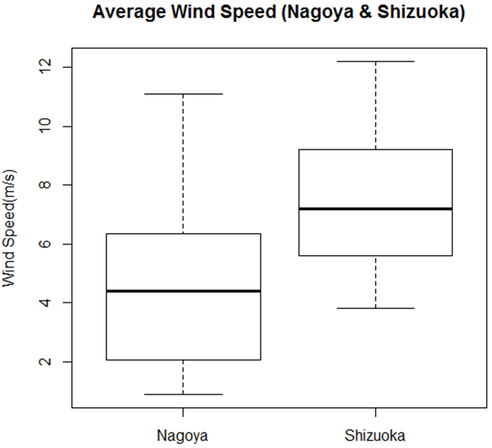
A Comparison of the Average Wind Speed
between Nagoya and Shizuoka
This is a box plot of the average wind speed.
The box plot of the left side represents those from Nagoya, and the box plot on the right side represents those
from Shizuoka.
I used the data of the wind speed when each station pressure was less than 1000 hPa.

Slide 14
A Comparison of the Average Wind Speed
between Nagoya and Shizuoka
If we look at these box plots, we can confirm that the wind speed in Shizuoka City is stronger than that in Nagoya City.

Slide 15
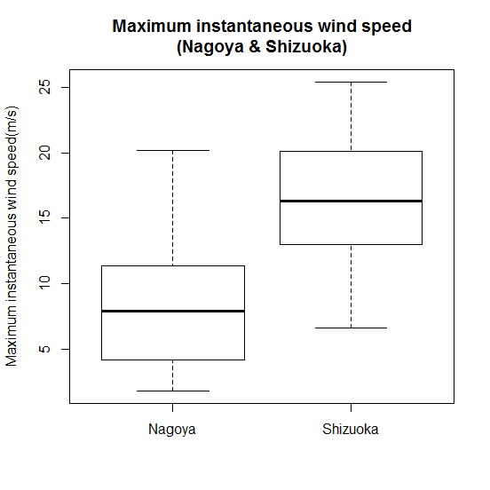
A Comparison of the Maximum Instantaneous Wind Speed between Nagoya and Shizuoka
If we analyze the maximum instantaneous wind speed, we will find the same results concerning the average wind speed.

Slide 16
The second analysis
of the typhoon's data is to research
the relationship between station
pressure and average wind speed.

Slide 17
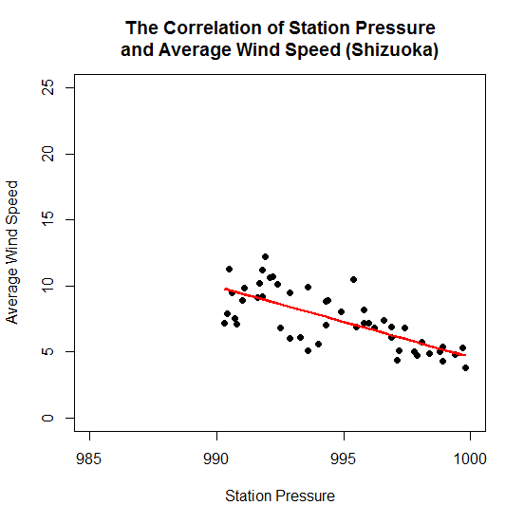
This scatter diagram expresses the relationship between station pressure and average wind speed in Shizuoka.
If we look at this scatter diagram, we come to
conclude that there is a negative correlation.
According to the t-test of the correlation coefficient, we can confirm that there is a strong negative correlation.
The value of the correlation coefficient is approximately
-0.72.
If the station pressure is low, the average wind speed is strong.

Slide 18
This scatter diagram expresses the relationship between station pressure and average wind speed in Shizuoka.
The equation of the regression line is
y=-0.54 x +540.
Because the correlation is strong, we can predict the average wind speed by the value of station pressure.

Slide 19
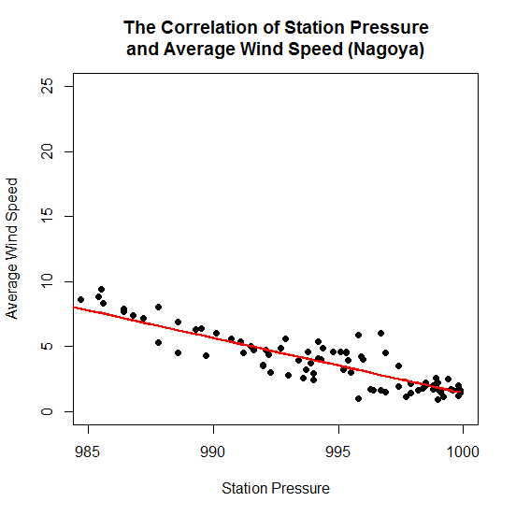
This scatter diagram expresses the relationship between station pressure and average wind speed in Nagoya.
There is a strong negative correlation too.
The value of the correlation coefficient is about -0.89.
The equation of the regression line is
y=-0.42 x +426.
As in the case of Shizuoka, because the correlation is strong, we can predict the average wind speed by the value of the station pressure.

Slide 20
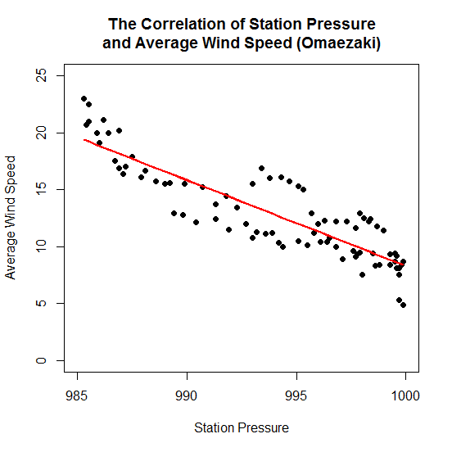
This scatter diagram expresses the relationship between station pressure and average wind speed in Omaezaki.
There is a strong negative correlation too.
The value of the correlation coefficient is approximately
-0.88.
The equation of the regression line is
y=-0.75 x +761.
As in the case of Shizuoka or
Nagoya, because the correlation is strong, we can predict the average wind speed by the value of the station pressure.

Slide 21
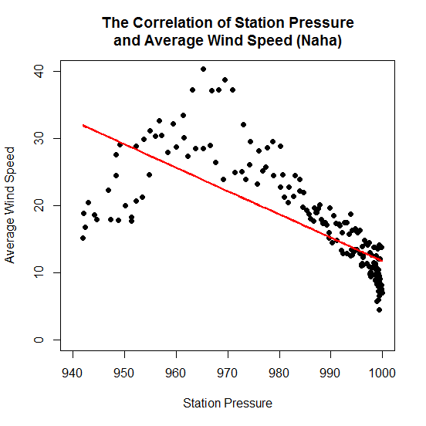
This scatter diagram expresses the relationship between station pressure and average wind speed in Naha.
If we look at this scatter diagram, we find that the shape of it is different from those of other scatter diagrams.

Slide 22
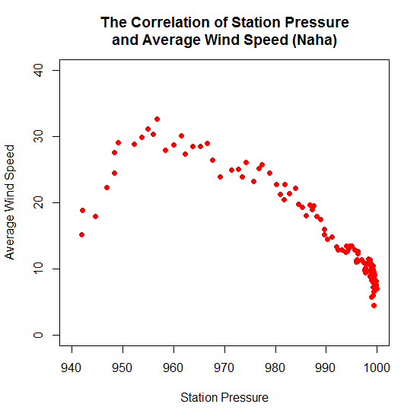
This scatter diagram expresses the relationship between station pressure and average wind speed in Naha before
the center of the
typhoon approached.

Slide 23
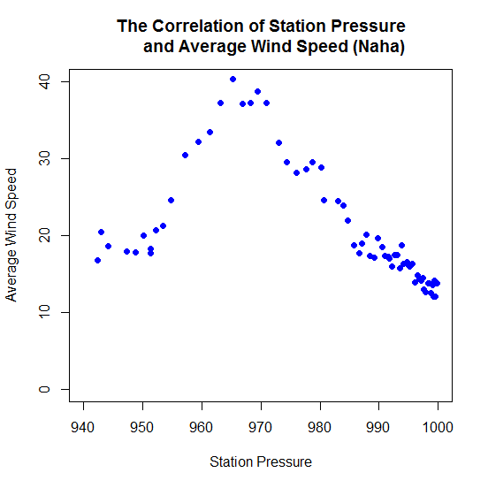
This scatter diagram expresses the relationship between station pressure and average wind speed in Naha after
the center of the
typhoon had passed.

Slide 24
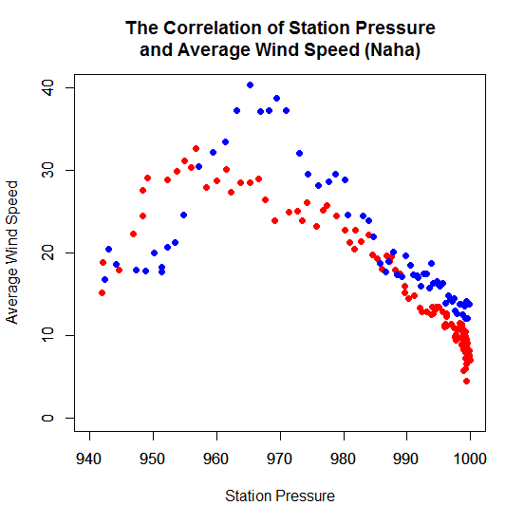
This scatter diagram expresses the relationship between station pressure and average wind speed in Naha.
This shape means that the wind speed near the typhoon's center is weak.

Slide 25
The third analysis
of the typhoon’s data is to research a
relationship between average wind
speed and maximum instantaneous
wind speed.

Slide 26
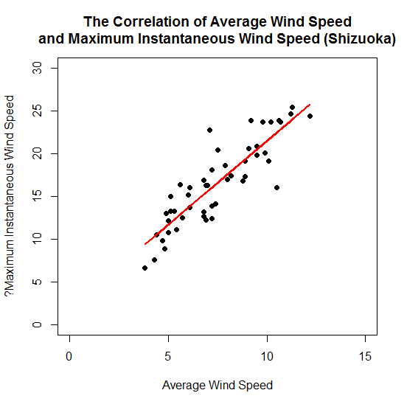
This scatter diagram expresses the relationship between average wind speed and maximum instantaneous wind
speed in Shizuoka.
There is a strong positive correlation.
The value of the correlation coefficient is approximately 0.87.
The equation of the regression line is
y=1.95 x +1.96.
Because the correlation is strong, we can predict the maximum instantaneous wind speed using the average wind speed.

Slide 27
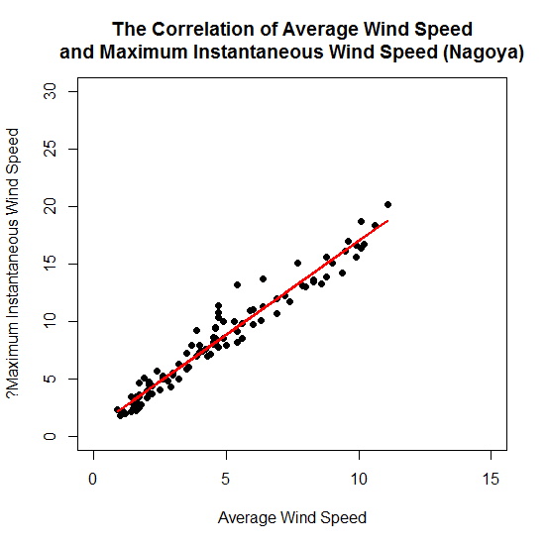
This scatter diagram expresses the relationship between average wind speed and maximum instantaneous wind
speed in Nagoya.
There is a strong positive correlation too.
The value of the correlation coefficient is approximately 0.98.
The equation of the regression line is
y=1.63 x +0.68.

Slide 28
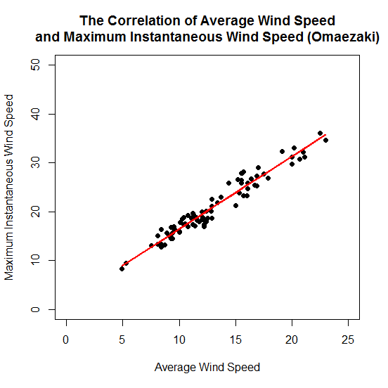
This scatter diagram expresses the relationship between average wind speed and maximum instantaneous wind
speed in Omaezaki.
There is a strong positive correlation too.
The value of the correlation coefficient is approximately 0.97.
The equation of the regression line is
y=1.49 x +1.55.

Slide 29
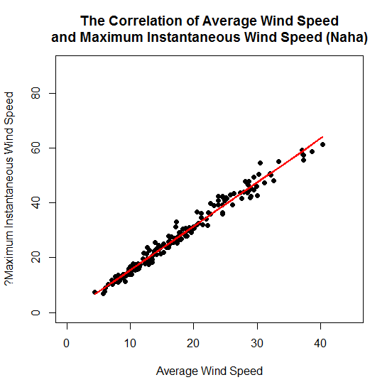
This scatter diagram expresses the relationship between average wind speed and maximum instantaneous wind
speed in Naha.
There is a strong positive correlation too.
The value of the correlation coefficient is approximately 0.99.
The equation of the regression line is
y=1.60 x -0.43.

Slide 30
From the first analysis,
the wind speed on right side of the typhoon is stronger than that of the left side of the typhoon.
From the second analysis,
if the station pressure is low, the wind speed is strong. If we use a regression line, there will be a possibility to be able to predict wind speed by the station pressure.
From the third analysis,
the maximum instantaneous wind speed of the typhoon is approximately 1.5 times the average wind speed.

